Slide 1
AWS Capstone mini-PROJECT:
Bank APPlication & ANALYTICS
GOpikrishna Cherukuri
8179970

Slide 2
Agenda
Project Details
Architecture & Orchestration
S3 Bucket Structure
Glue Components
Business Analytics - SQL Queries
ReadME Section

Slide 3
Project Details
Banking Analytics Lakehouse that processes daily transaction files for banking customers and stores them in Amazon S3 Tables—a purpose-built storage tier for Apache Iceberg that provides high-performance transactional consistency.
We analyse the behaviour of banking customers, bank performance and analytics based on customer transactional data.

Slide 4



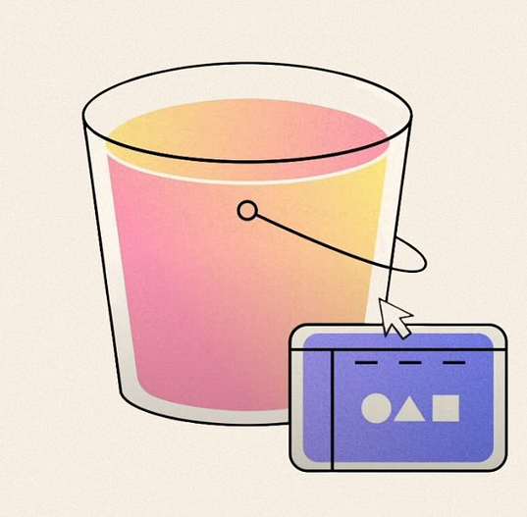


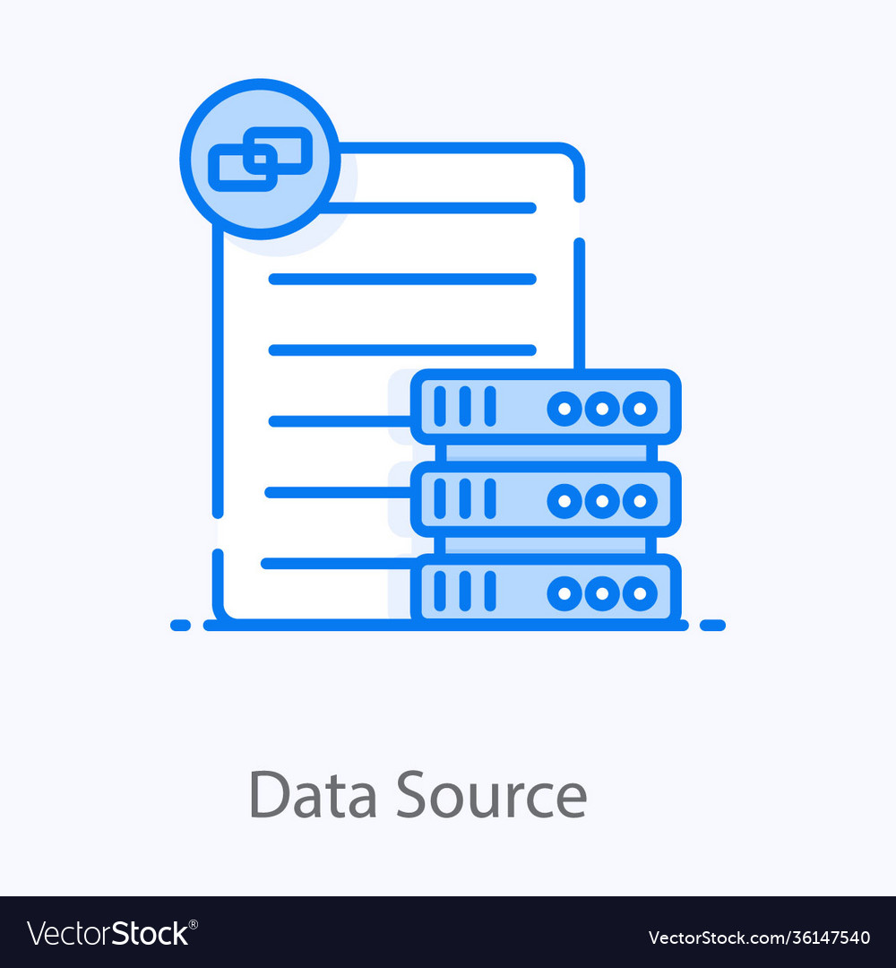
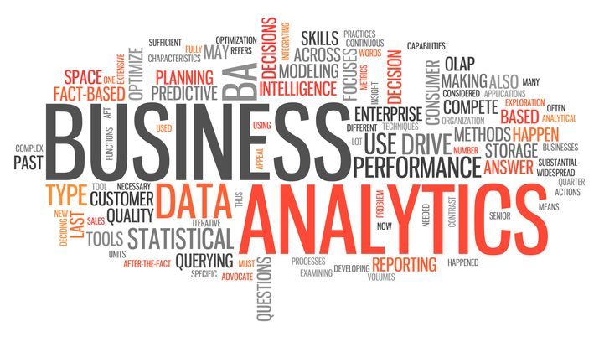
Project Architecture & Orchestration
SNS Email Notification
Bank customer data in S3
(s3://bank-app-data-landing-area/raw/)
S3 Iceberg
Warehouse
Send
Glue Catalog
Athena
II
generate data
processed by
writes enriched data
Python Program
Data Source
Glue ETL Job
(ETLBankAppAnalytics)
s3://bank-app-lakehouse-iceberg/warehouse/
analytics_db
analytics

Slide 5
Data Sets
customers.csv
    customer_id, name, email, country
accounts.csv
    account_id,customer_id,account_type,balance
Transactions.csv
    txn_id, account_id, amount, txn_type, timestamp

Slide 6
S3 Bucket Structure
Raw Data - S3 Bronze Data Bucket:
s3://bank-app-data-landing-area/raw/
├── customers/
│ └── yyyy-mm-dd/
│ └── customers.csv
├── accounts/
│ └── yyyy-mm-dd/
│ └── accounts.csv
└── transactions/
└── yyyy-mm-dd/
└── transactions.csv
Iceberg Warehouse – S3 Curated Data Bucket:
s3://bank-app-lakehouse-iceberg/warehouse/
└── analytics_db.db/
└── enriched_transactions/
├── data/
└── metadata/

Slide 7
Glue Components – ETL Job
ETLBankAppAnalytics
Reads daily CSV files from S3 (Bronze layer).
Transforms and enriches the data.
Loads data incrementally into an Iceberg table (partitioned by txn_date).
Sends SNS email alerts on START, SUCCESS, and FAILURE

Slide 8
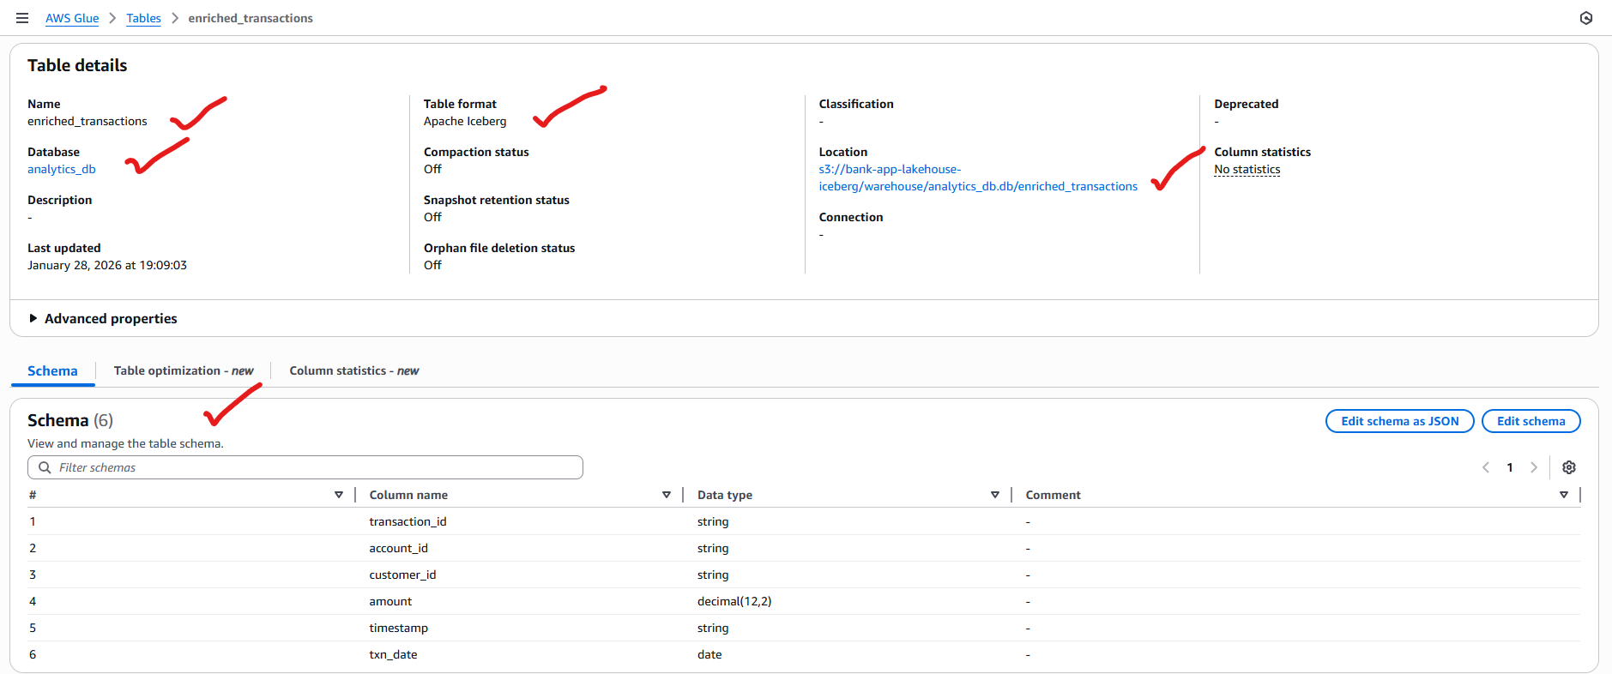
Glue Components – Catalog
enriched_transactions : Iceberg Table (analytics_db)

Slide 9
Business Analytics - SQL Queries
    Most/Avg Spending Customers by Transaction Value
    Fraud Detection & Alerts
    Find Inactive Customers

Slide 10
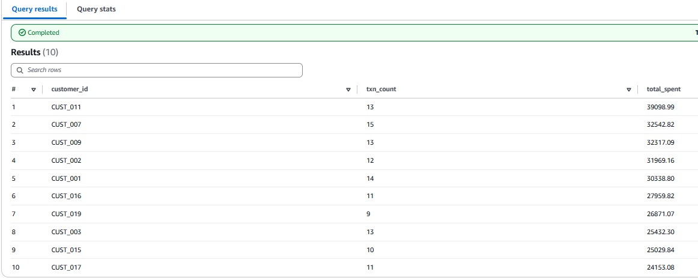
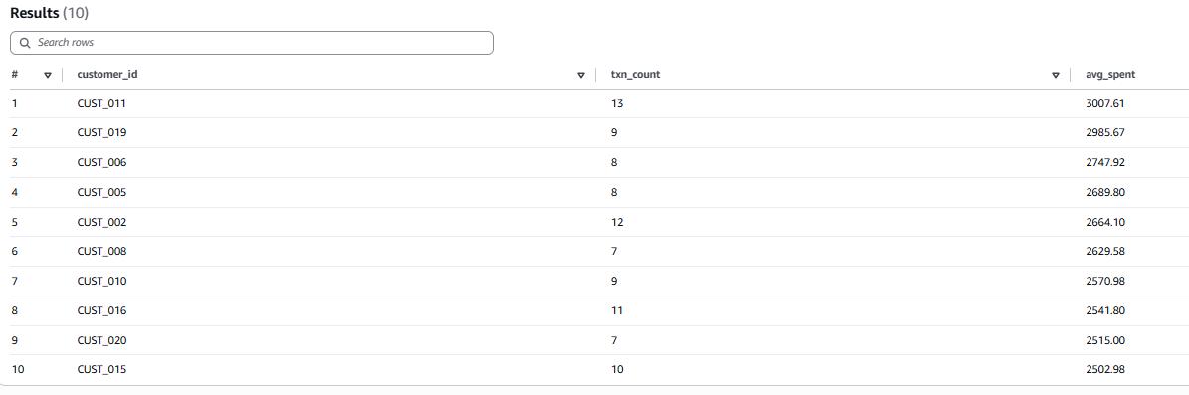
SQL Queries: Most/Avg Spending Customers by Transaction Value
SELECT
customer_id,
COUNT(*) AS txn_count,
SUM(amount) AS total_spent
FROM analytics_db.enriched_transactions
GROUP BY customer_id
ORDER BY total_spent DESC
LIMIT 10;
SELECT
customer_id,
COUNT(*) AS txn_count,
SUM(amount) AS avg_spent
FROM analytics_db.enriched_transactions
GROUP BY customer_id
ORDER BY avg_spent DESC
LIMIT 10;

Slide 11
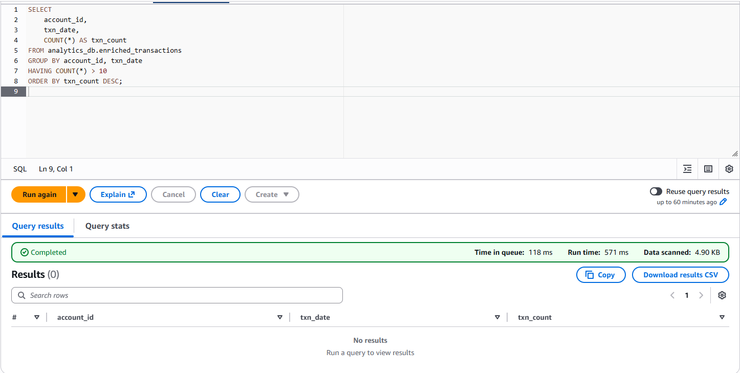
    SQL Queries: Fraud Detection & Alerts
Multiple Transactions Same Day (Burst Activity) - Suspicious accounts with high no. of transactions activity in a same day.
SELECT
account_id,
txn_date,
COUNT(*) AS txn_count
FROM analytics_db.enriched_transactions
GROUP BY account_id, txn_date
HAVING COUNT(*) > 20
ORDER BY txn_count DESC;

Slide 12
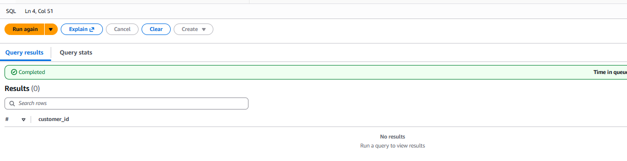
    SQL Queries: Inactive customers
SELECT DISTINCT customer_id
FROM analytics_db.enriched_transactions
GROUP BY customer_id
HAVING MAX(txn_date) < current_date - INTERVAL '30' DAY;

Slide 13
README Section
Git Hub link to ReadME section:
aws-project-analytics-in-banking/README.md at main · chgopikrishnamca/aws-project-analytics-in-banking

Slide 14

Thank you!
Comments & Suggestions ?

